Slide 1
Chapter 5 Human genetics
Page 90

Slide 2
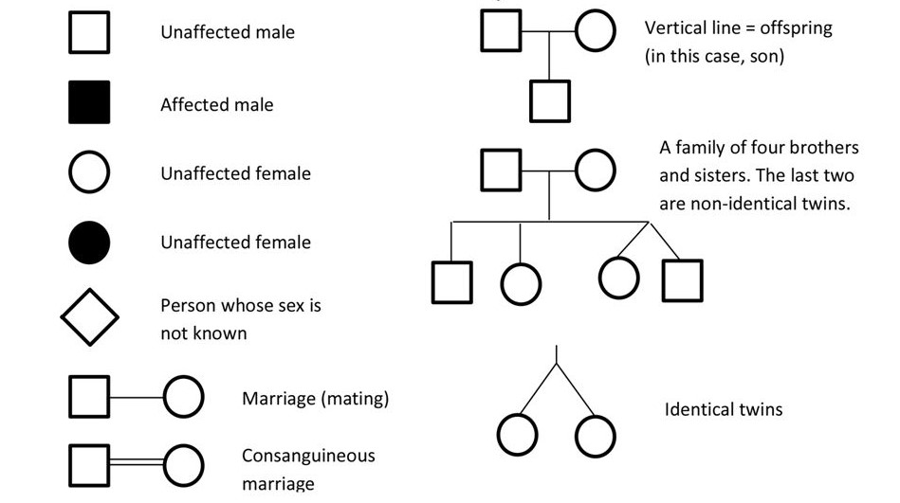
Pedigree: symbols:

Slide 3
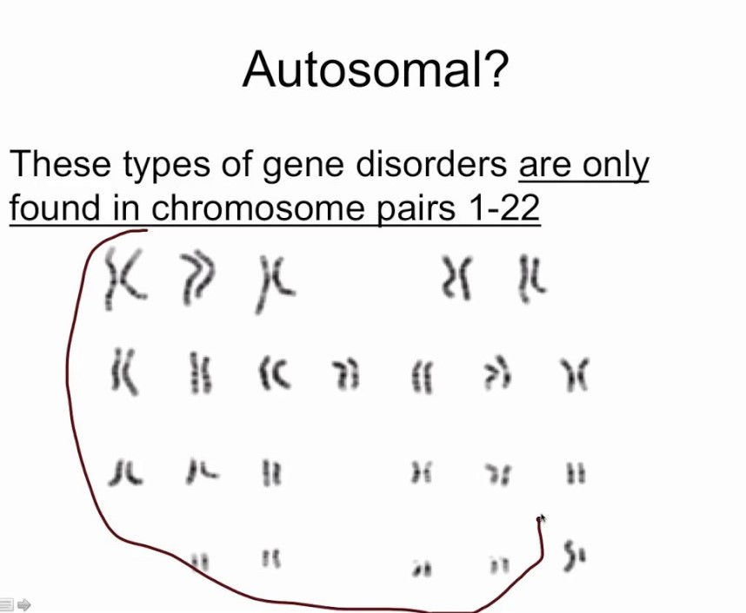
Autosomal gene:

Slide 4
Case of autosomal disease:(copy)
Males and females are infected by the disease (behaves the same in both males and females).
The gene responsible about the disease is located on one of the autosomal pairs of homologous chromosomes.
The genotype of an autosomal gene is represented by two alleles in both males and females.

Slide 5
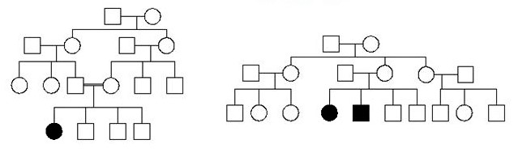
Recessive autosomal disease:(copy)
Pedigree 1 Pedigree 2
To prove that the disease is recessive:
Pedigree 1: Since the affected girl by the disease has normal parents from which she should inherit the diseased alleles, so the allele responsible about the disease in the girl was masked in both parents.
Pedigree 2: Both the affected girl and boy by the disease has normal parents from which they should inherit the diseased alleles, so the alleles responsible about the disease in them were masked in their parents.
Note that you can know that it is an autosomal case if you find in the pedigree affected sister and affected brother who have normal father.

Slide 6
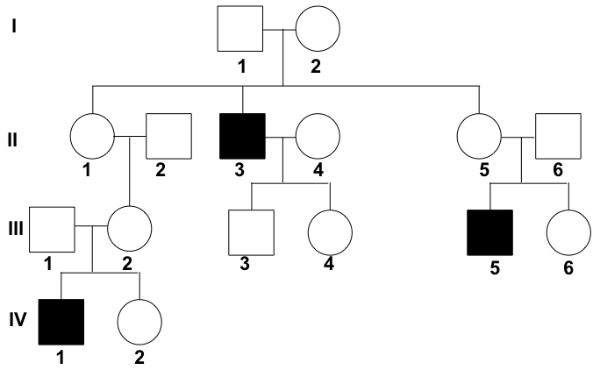
Signs that indicate that the localization of the studied gene is sex-linked (gonosomal):
If the given pedigree shows that only boys are effected by the studied gene:
If it is given by the text that the gene is sex-linked:
if in results of gel electrophoresis, the number of fragments (bands) differ between males and females.
If a cross and its inverse is given, in which the results of descendants change depending on the gender of the affected parent:
Duchenne muscular dystrophy (DMD) is a severe type of muscular dystrophy that primarily affects boys.[content. Females with a single copy of the defective gene may show mild symptoms.
The disorder is X-linked recessive. About two thirds of cases are inherited from a person's mother, while one third of cases are due to a new mutation.
Disease is dominant:
1. Affected mother x normal father result: ½ girls are affected, ½ girls are normal, ½ boys are affected, ½ boys are normal.
2. Normal mother x affected father result: All girls are affected, all boys are normal.

Slide 7
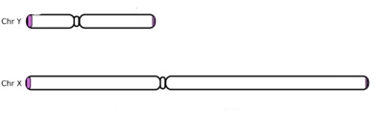
Schematic representation of X and Y chromosomes (Copy):
Homologous segment of X and Y chromosomes
Non-homologous of chromosome Y
Non-homologous of chromosome X

Slide 8
To verify that the localization of the gene is autosomal (Copy):
1. Neglet gene localization on non-Homologous chromosome of X:
(note that: genes located on non-homologous segment of X chromosome exist in one copy in males and two copies in females).
2. Neglet gene localization of non-homologous segment of chromosome of Y.
(note that: genes located on the non-homologous segment of chromosome Y are expressed in one copy in males and are not expressed in females).
3. Neglet gene localization on homologous segment of chromosomes X and Y.
(note that: genes located on homologous segments of X and Y have two alleles both in males and females and thus behave as autosomal).
(Take a boy and a girl who are affected by the disease and have a normal father as in the case below).
X Y
Non-Homologous of chromosome Y
Homologous of X and Y
Non-Homologous of chromosome X

